Slide 1
LECTURE THREE Differential Analysis: The Key to Decision Making
©2020 McGraw-Hill Education. All rights reserved. Authorized only for instructor use in the classroom. No reproduction or further distribution permitted without the prior written consent of McGraw-Hill Education.

Slide 2
Decision Making
Every decision involves choosing from among at least two alternatives. Therefore, the first step in decision-making is to define the alternatives being considered.
Once you have defined the alternatives, you need to identify the criteria for choosing among them.
Relevant costs and relevant benefits should be considered when making decisions.
Irrelevant costs and irrelevant benefits should be ignored when making decisions.

Slide 3
Relevant and Irrelevant Costs
Relevant Cost:
An incremental cost is an increase in cost between two alternatives.
An avoidable cost is a cost that can be eliminated by choosing one alternative over another.
Irrelevant Costs
A sunk cost is a cost that has already been incurred and cannot be changed regardless of what a manager decides to do.
Future costs and benefits that do not differ between alternatives are irrelevant to the decision-making process

Slide 4
Opportunity costs also need to be considered when making decisions.
An opportunity cost is the potential benefit that is given up when one alternative is selected over another.

Slide 5
Total and Differential Cost Approaches
Using the differential approach is desirable for two reasons:
Only rarely will enough information be available to prepare detailed income statements for both alternatives.
Mingling irrelevant costs with relevant costs may cause confusion and distract attention away from the information that is really critical.

Slide 6
First :Keeping/Dropping Segments
One of the most important decisions managers make is whether to keep or drop a business segment. Ultimately, a decision to drop an old segment or add a new one is going to hinge primarily on its financial impact.
To assess this impact, it is necessary to carefully analyze the costs.

Slide 7
Keeping/Dropping Segments
Due to the declining popularity of digital watches, Lovell Company’s digital watch line has not reported a profit for several years. Lovell is considering whether to keep this product line or drop it.

Slide 8
A Contribution Margin Approach
Decision Rule
Lovell should drop the digital watch segment only if its profit would increase.
Lovell will compare the contribution margin that would be lost if the digital watch line was discontinued to the fixed expenses that would be avoided if the line was discontinued.

Slide 9
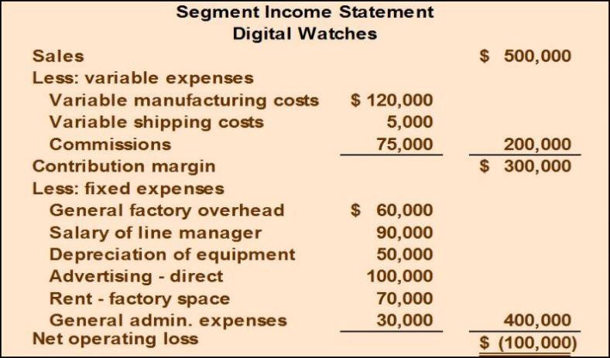
Adding/Dropping Segments – Example –
Access the text alternative for slide images.
Notes:
Fixed Costs = 400,000
Avoidable (Can be saved) Non avoidable (cant be saved)
= Traceable Common= Allocated=Shared
260,000 60,000 +30,000 +sunk 50,000=140,000
Sales 500,000
-TVC 200,000
= Contribution Margin 300,000
Traceable FC 260,000
= Segment margin =40,000
-Common costs -140,000
Net income -100,000

Slide 10
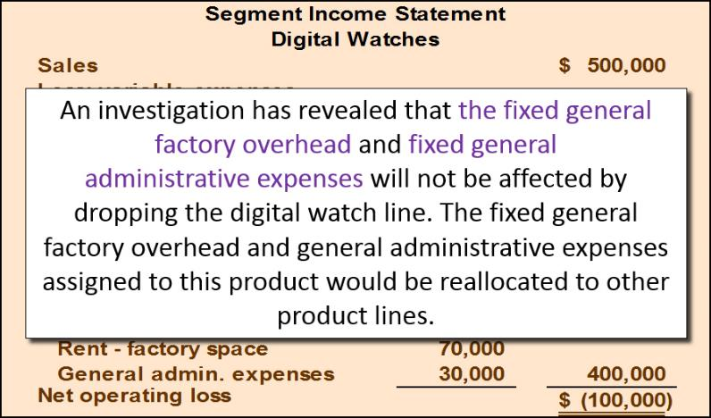
Adding/Dropping Segments – Example –

Slide 11
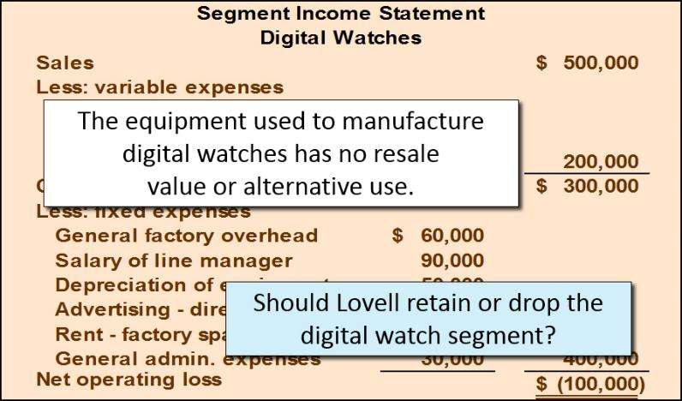
Adding/Dropping Segments – Example

Slide 12
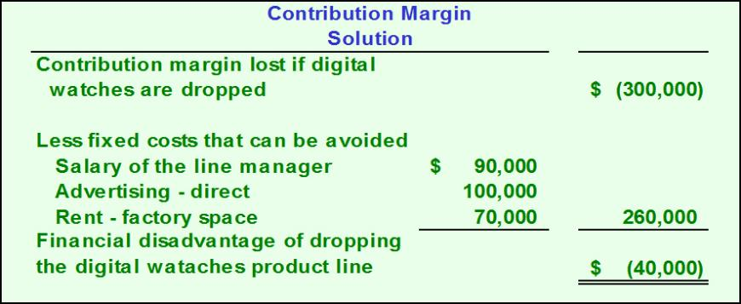
Contribution Margin Approach Solution
Access the text alternative for slide images.

Slide 13
Comparative Income Approach
The Lovell solution can also be obtained by preparing comparative income statements showing results with and without the digital watch segment.
Let’s look at this second approach.

Slide 14
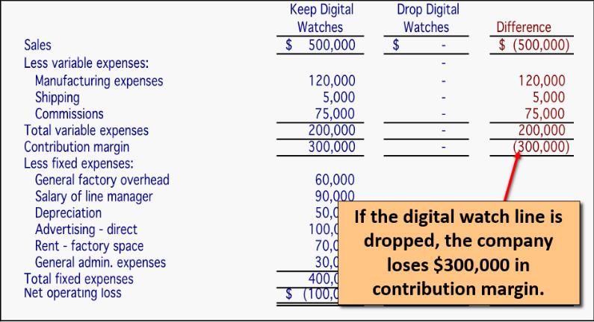
Comparative Income Approach
Access the text alternative for slide images.

Slide 15
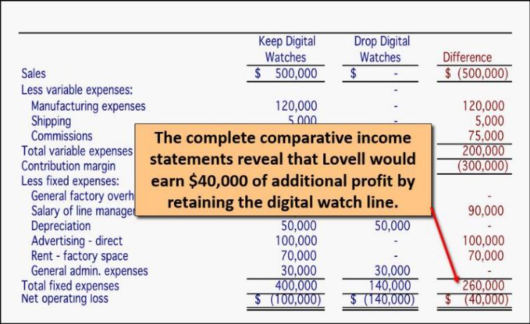
Comparative Income Approach
Access the text alternative for slide images.

Slide 16
Beware of Allocated Fixed Costs
Be aware that allocated fixed costs can distort the keep/drop decision.
Lovell’s managers may ask: “Why should we keep the digital watch segment when it’s showing a $100,000 loss?”
The answer lies in the way we allocate common fixed costs to our products.

Slide 17
Beware of Allocated Fixed Costs
Including unavoidable common fixed costs makes the product line appear to be unprofitable, when in fact dropping the product line would decrease the company’s overall net operating income.

Slide 18
Second: Make or Buy Decision
When a company is involved in more than one activity in the entire value chain, it is vertically integrated. A decision to carry out one of the activities in the value chain internally, rather than to buy externally from a supplier is called a “make or buy” decision.

Slide 19
The Make or Buy Decision – An Example
Essex Company manufactures part 4A that is used in one of its products. The unit product cost of this part is:
Direct materials | $ 9
Direct labor | 5
Variable overhead | 1
Depreciation of special equipment | 3
Supervisor’s salary | 2
General factory overhead | 10
Unit product cost | $ 30

Slide 20
The Make or Buy Decision
The special equipment used to manufacture part 4A has no resale value.
The total amount of general factory overhead, which is allocated on the basis of direct labor hours, would be unaffected by this decision.
The $30 unit product cost is based on 20,000 parts produced each year.
An outside supplier has offered to provide the 20,000 parts at a cost of $25 per part.
Should the company stop making part 4A and buy it from an outside supplier?

Slide 21
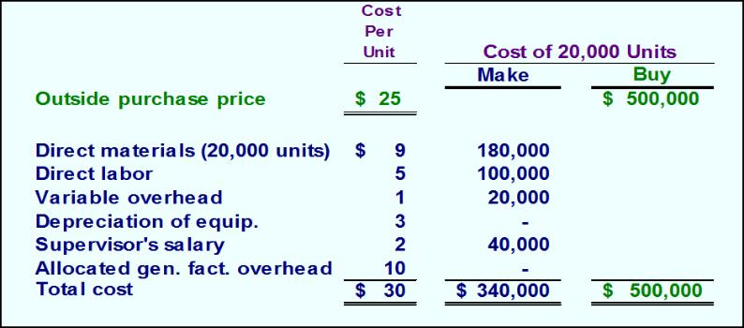
The Make or Buy Decision
The avoidable costs associated with making part 4A include direct materials, direct labor, variable overhead, and the supervisor’s salary.
Access the text alternative for slide images.

Slide 22
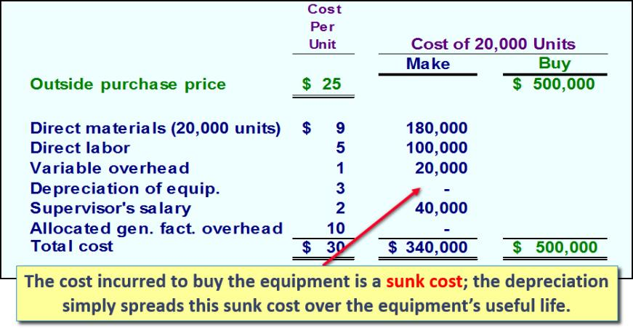
The Make or Buy Decision

Slide 23
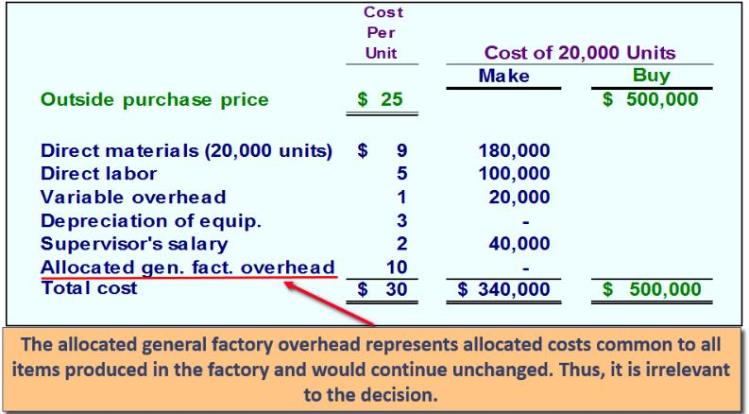
The Make or Buy Decision

Slide 24
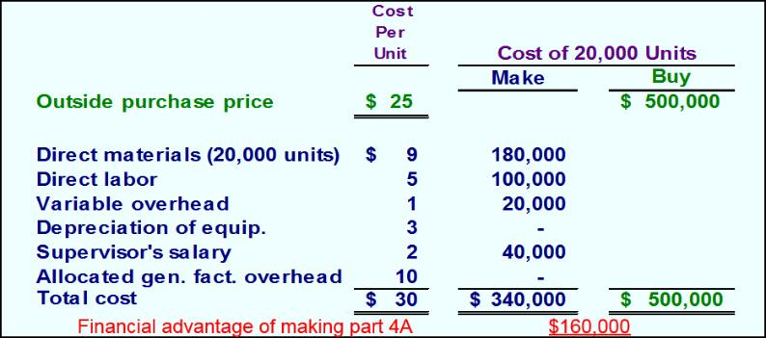
The Make or Buy Decision
Should we make or buy part 4A? Given that the total avoidable costs are less than the cost of buying the part, Essex should continue to make the part.

Slide 25
Opportunity Cost
Opportunity costs are not actual cash outlays and are not recorded in the formal accounts of an organization.
An opportunity cost is the benefit that is foregone as a result of pursuing some course of action.
If the space to make Part 4A had an alternative use, the opportunity cost would have been equal to the segment margin that could have been derived from the best alternative use of the space.

